Slide 1
Floating point number representation

Slide 2
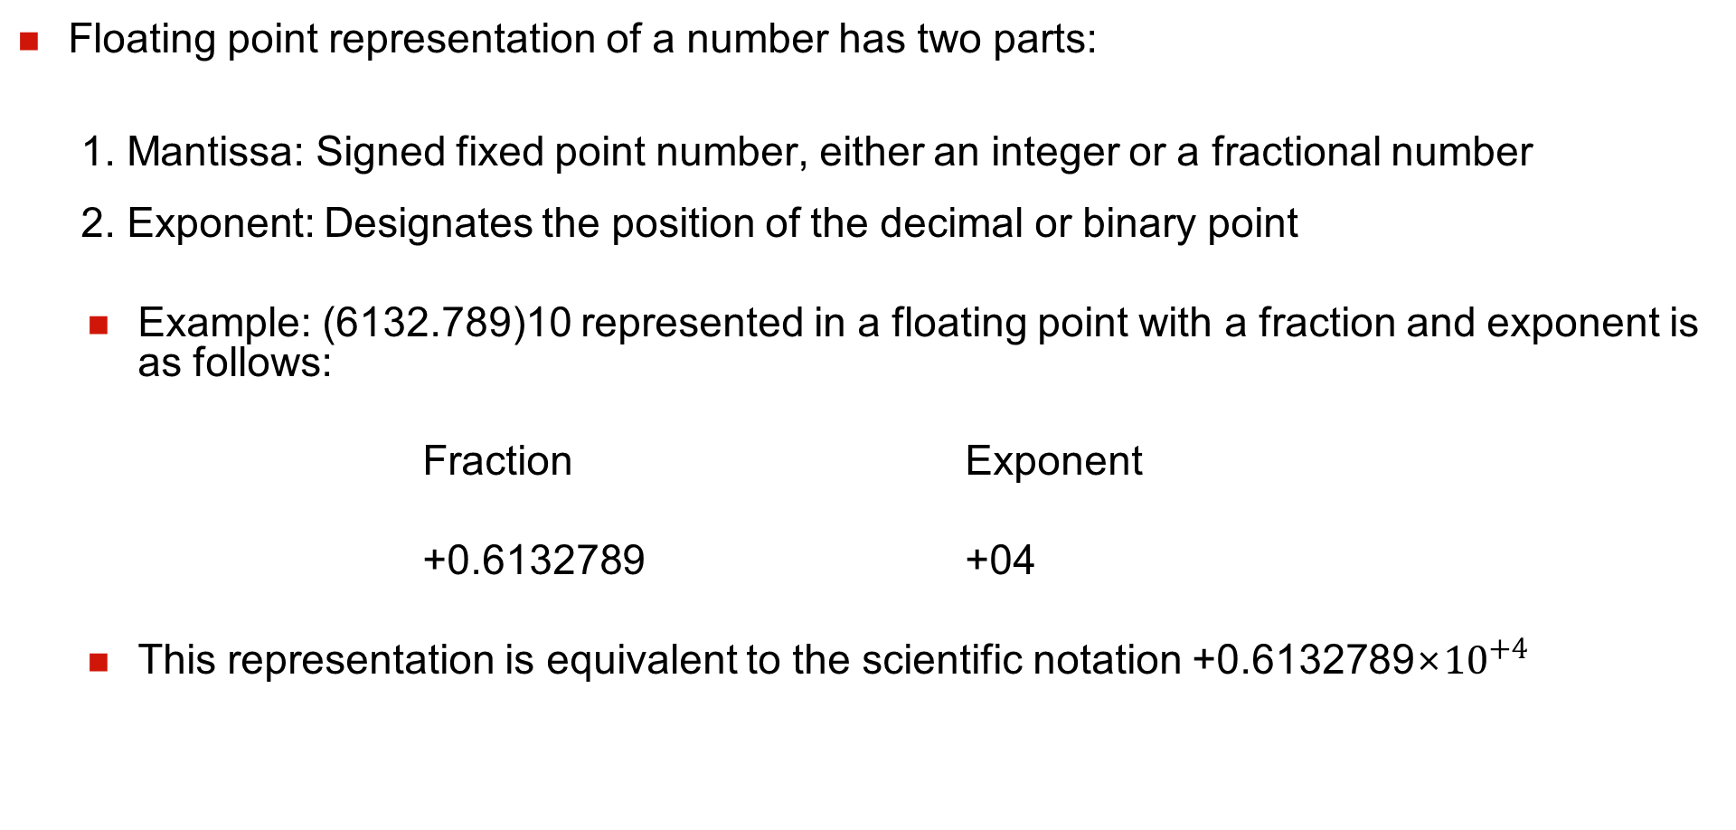
FLOATING POINT REPRESENTATION
Floating point representation of a number has two parts:
1. Mantissa: Signed fixed point number, either an integer or a fractional number
2. Exponent: Designates the position of the decimal or binary point
Example: (6132.789)10 represented in a floating point with a fraction and exponent is as follows:
Fraction Exponent
+0.6132789 +04
This representation is equivalent to the scientific notation +0.6132789×${10}^{+4}$

Slide 3
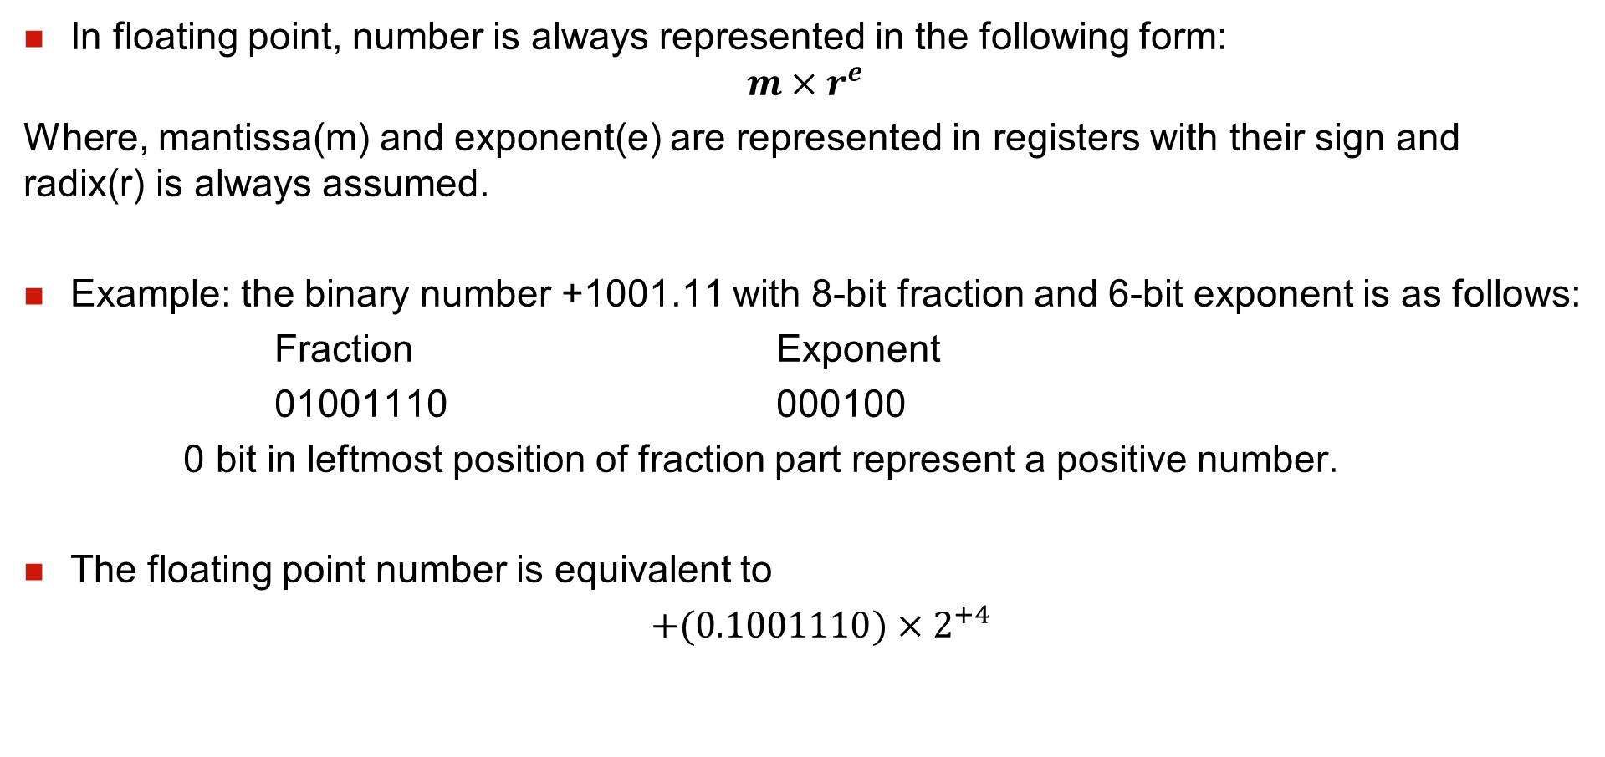
FLOATING POINT NUMBERS
In floating point, number is always represented in the following form:
$$m×r^{e}$$
Where, mantissa(m) and exponent(e) are represented in registers with their sign and radix(r) is always assumed.
Example: the binary number +1001.11 with 8-bit fraction and 6-bit exponent is as follows:
Fraction Exponent
01001110 000100
0 bit in leftmost position of fraction part represent a positive number.
The floating point number is equivalent to
$+(0.1001110)×2^{+4}$

Slide 4
NORMALIZATION OF FLOATING POINT NUMBER
A floating point number is said to be normalized if the most significant position of the mantissa is a non-zero.
350 decimal number is normalized but 0035 is not.
8-bit binary number 00101010 is not normalized but 10101010 is normalized.
A zero cannot be normalized because it does not have non zero digit.
It takes longer execution time due to complicated arithmetic operation and requires more complex hardware.

